Slide 1
03.02
Linear Regression - Regularisation
Level 7 Artificial Intelligence (AI) Data Specialist
Python, Tools and Steps to Build AI Models
Georgina Thomas
g.thomas@learn-tech.com

Slide 2
Regularisations

Slide 3
Regularisations
Linear Regression is the most basic method from the regression family, where the model is not penalised for its choice of weights at all. However, this means that during the training process, if the model considers a particular feature important, it will assign a large weight to that feature. This can sometimes cause overfitting in smaller datasets.
Lasso, Ridge, and ElasticNet are methods from the linear regression family that penalize the model for its weights. They reduce model complexity and prevent over-fitting.

Slide 4
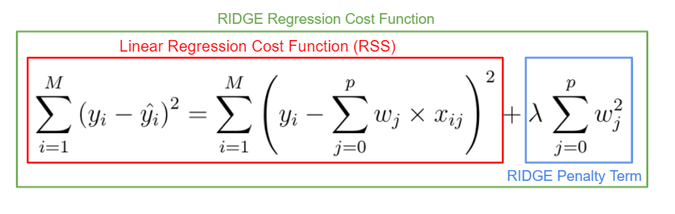
Ridge
In Ridge regression, the cost function is altered by adding a penalty equivalent to the square of the magnitude of the coefficients.
The penalty term lambda('alpha’ = 1.0(default) in Scikit Learn) regularises the coefficients such that if the coefficients take large values, the optimisation function is penalised.
The higher the lambda(alpha) is, the bigger the penalty term, and therefore, the magnitude of the coefficients is reduced.
Therefore, Ridge regression shrinks the coefficients, which helps reduce model complexity and mitigate multicollinearity.

Slide 5
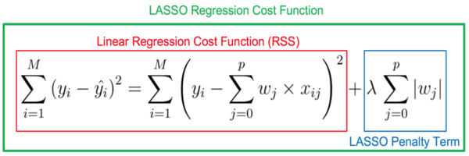
Lasso
Lasso is a modified linear regression method where the model is penalised for the sum of the absolute values of the weights.
The absolute value of weight tends to be reduced. Some of them may be reduced to zeros.
So, the only difference between Ridge and Lasso is that instead of taking the square of the coefficients, magnitudes are taken into account.

Slide 6
ElasticNet
ElasticNet is a hybrid of Lasso and Ridge, where both absolute value penalisation and squared penalisation are included, regulated by the L1_ratio coefficient. The L1_ratio takes values between 0 and 1.
L1_ratio = 0 is the Lasso penalty.
L1_ratio = 1 is the Ridge penalty.
L1_ratio between 0 and 1 is a combination of the Ridge and Lasso penalty.
For Alpha = 0, it is equivalent to Linear Regression(no penalty at all).

Slide 7
Complete the notebook on regularisation.

